Slide 1
Quiz App using HTML, CSS, and JavaScript
NAME : HARIDHARAN
DEPARTMENT :BCA
COLLEGE :S.S ART AND SCIENCE COLLEGE
REGISTER NO:DC837A67AF2FF2F8FC440FD9BAA6E714

Slide 2
AGENDA
1. INTRODUCTION
2. OBJECTIVES
3. TOOLS AND TECHNOLOGIES
4. WORKING PROCESS
5. SYSTEM FLOW
6. FEATURES
7. SAMPLE OUTPUT
8. FUTURE ENCHANCEMENT
9. CONCLUSION

Slide 3
Introduction
The Quiz App is a simple yet powerful web-based application designed to test knowledge through multiple-choice questions. It is built using three core web technologies—HTML for the structure, CSS for styling, and JavaScript for adding logic and interactivity. Users answer a series of questions, and their score is displayed at the end of the quiz. This project demonstrates how front-end development concepts can be combined to create an interactive learning tool.

Slide 4
Objectives
The main objective of this project is to practice JavaScript-based interactivity by implementing a multiple-choice quiz system. It aims to help learners understand how to manage user input, evaluate answers, and display results dynamically. Another goal is to track the user’s score throughout the quiz and provide instant feedback at the end. Overall, the project helps in strengthening DOM manipulation skills while building a functional and engaging application.

Slide 5
Tools & Technologies
The Quiz App makes use of core web development technologies. HTML5 is used to create the structure of the quiz, including questions, buttons, and the layout of the interface. CSS3 is applied to style the application, making it visually appealing and user-friendly. JavaScript (ES6) is used for the application’s logic, such as loading questions, checking answers, tracking the score, and moving to the next question. The project runs entirely inside a browser, making it lightweight and accessible.

Slide 6
Working Process
The quiz works through a simple but effective process. Questions and answers are stored in a JavaScript array. When the quiz starts, the first question is displayed along with multiple answer options. When a user selects an answer, the application checks whether it is correct and updates the score accordingly. After that, the user can proceed to the next question by clicking the “Next” button. Once all questions are answered, the application calculates the total score and displays it to the user along with an option to restart the quiz.

Slide 7
System Flow
The system flow begins with loading a question from the database or array. Users then select their answer from the given options. If the chosen answer matches the correct one, the score increases by one. The quiz continues to present the next question until all questions are completed. Once the quiz ends, the system displays the final score and provides an option to restart the quiz, ensuring a smooth and continuous user experience.

Slide 8
Features
The Quiz App comes with several simple yet useful features. It supports multiple-choice questions, each with four possible options. The app tracks the user’s score and displays the result at the end of the quiz. A restart button allows users to retake the quiz without refreshing the page manually. Additionally, the application is lightweight, responsive, and easy to use, making it suitable for both beginners and experienced learners.

Slide 9
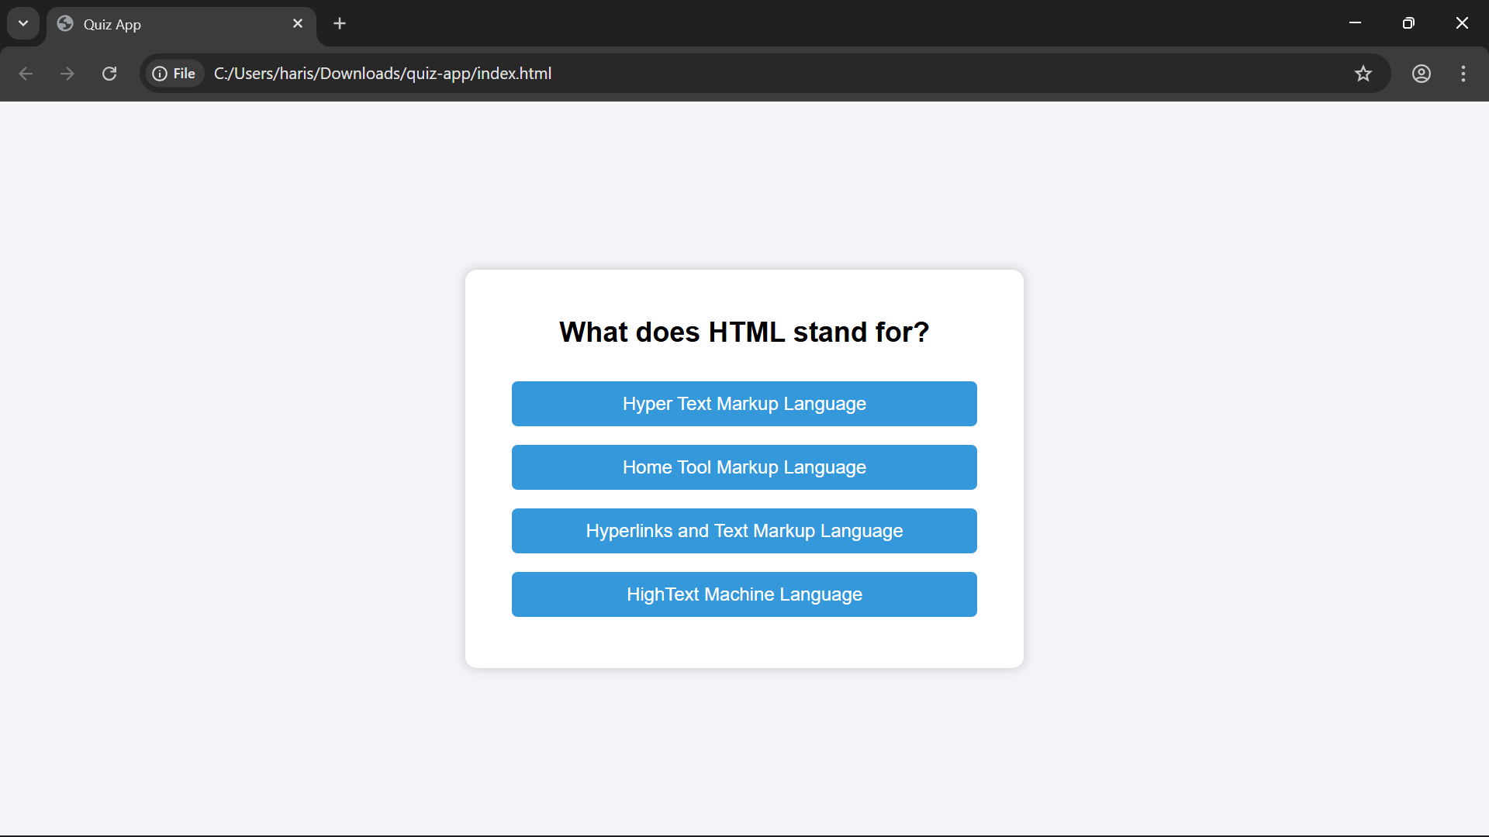
Sample Output

Slide 10
Future Enhancements
There are many possible improvements to this basic Quiz App. A timer could be added to limit the time for each question, making the quiz more challenging. Another useful feature would be highlighting correct and wrong answers immediately after selection. A progress bar could also be included to show how many questions are left. In more advanced versions, questions could be fetched dynamically from a database or external API, allowing for larger and more flexible quiz sets.

Slide 11
Conclusion
In conclusion, the Quiz App is a simple yet practical project that demonstrates how HTML, CSS, and JavaScript can be used together to build interactive web applications. It allows learners to apply fundamental front-end development concepts while creating something fun and functional. The project not only reinforces coding knowledge but also lays the foundation for building more advanced web-based learning tools in the future.

